Slide 1
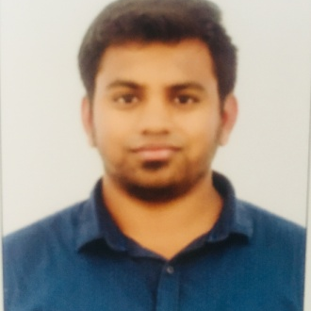
SRINATH D.S
Senior Test Analyst
Test Engineering Senior Analyst
Srinath is a Test Engineering Senior Analyst with Accenture Technology Solutions in India with proficiency in Functional Test Planning ,Selenium, keyword driven, and Page Object Model framework.
He has 7.5 years of IT experience working with clients from many different industries focusing on Logistic domain(FedEx), Banking(Morgan Stanley)
Empower (Accenture)
2 + years experience in Automation web-based testing in Selenium/web driver and APIs automation experience in BDD Cucumber, TestNG, Maven.
5 years of Rich experience with analysis, design, execution of Test Scenarios of web-based applications, Bug Life Cycle, Regression, Functional, Sanity.
He has been involved in various phases of software testing including Analysis of functional requirements, designing test cases, UI testing , Automation scripting in web application & APIs using REST.
Experienced in both waterfall model and agile methodologies
Client: Empower
Technologies: JIRA/Cucumber
Role: Functional Tester
Understanding and analyzing the Requirements for Epic and created test data for testing.
Participated in Requirement analysis discussion.
Writing Test case for user stories and bugs.
Worked in Agile environment and interacted with the Client, Analyst and Business team to test the application on time
Client: FEDEX (Logistics Domain)
Technologies: TestNG/REST Assured/Cucumber/GIT/Maven,ALM /JIRA
Role: Automation/Functional Tester
Participated in Requirement analysis discussion for automation
Automated web-based application using Test NG.
Involved in regression automation testing APIs using REST Assured.
Helped my junior peers in both functional and automation.
Client: Morgan Stanley(Capital Markets)
Technologies: Selenium/Cucumber/REST,HP ALM/JIRA/GIT
Role: Automation /Functional Tester
Automated test cases using Selenium – Java and Executed the automated scripts Supported team members to prepare and execute automation scripts.
Participated in Requirement analysis discussion.
Automated web-based applications with WebDriver and APIs using Karate framework.
Sharing the execution report to client and implementing the review comments/ additional validations and implanting the scripts.
Sending defect and Progress reports to onsite members based on release.
Responsible for giving Demo to clients during every release and document is created for each release.
ds.srinath@accenture.com
9791339233
Tools: Selenium-Automation, TestNG, GIT, Jira, Maven, BDD Cucumber ALM, Rest Assured, Karate, Jenkins
Programming language: Core java
Databases: SQL Basics
OS: Windows/Mac
Expertise in Functional Testing and Automation
Expertise in Functional Test Planning, Agile /Waterfall
Logistics, Web-based, Digital Banking Insurance,
Smoke, Sanity, Regression, E2E Testing, TestingUAT & Defect Management
Tools:
OCJP6
Bachelor of Information Technology from Jayram college of Engineering & technology, Dharmapuri.
Selenium- and Page Object Model framework
Core Java
Jenkins
JIRA
HP ALM
Maven
Cucumber
SQL(Basics
Test NG
Rest Assured

